Slide 1
Introduction to 8085

Slide 2
Introduction to 8085
8085 is pronounced as "eighty-eighty-five" microprocessor.
It is an 8-bit microprocessor designed by Intel in 1977 using NMOS technology.
Notes:
N-type metal-oxide-semiconductor logic

Slide 3
Introduction to 8085
8 bit General purpose microprocessor (i.e. 8 bit data bus).
It is a single chip N MOS device with 40 pins.
It has multiplexed address and data bus.(AD₀ - AD₇).
It works on 5-Volt DC power supply.
The maximum clock frequency is 3MHz while minimum frequency is 500kHz.
It provides 16 address lines, therefore capable of addressing 2¹⁶= 64K of memory.
It supports external interrupt request.
It has two 16 bit registers named program counters (PC) and stack pointer (SP).
Notes:
A NPN transistor has electrons as majority charge carriers whereas the PNP transistor has holes as majority charge carrier. The mobility of electrons is better than mobility of holes. So a NPN transistor is faster in operation than a PNP transistor.

Slide 4
Introduction to 8085
It generates 8 bit I/O address so it can access 2⁸ = 256 input ports.
It provides 5 hardware interrupts:
TRAP
RST 5.5
RST 6.5
RST 7.5
INTR
It provides accumulator, 5 flag register, 6 general purpose registers and 2 special purpose registers (SP,PC).

Slide 5
8085 Programming Model

Slide 6
8085 Programming Model
Accumulator A (8)
Flag Register
B (8)
C (8)
D (8)
E (8)
General Purpose Registers
H (8)
L (8)
Stack Pointer (SP) (16)
Program Counter (PC) (16)
Data Bus
Address Bus
8
16
Bidirectional
Unidirectional

Slide 7
General Purpose Registers
6 general purpose registers to store 8-bit data B, C, D, E, H & L.
Can be combined as fixed register pairs – BC, DE, HL to perform 16 bit operations.
Used to store or copy data using data copy instructions.
B (8)
C (8)
D (8)
E (8)
H (8)
L (8)

Slide 8
8085 Programming Model
Accumulator A (8)
Flag Register
B (8)
C (8)
D (8)
E (8)
H (8)
L (8)
Stack Pointer (SP) (16)
Program Counter (PC) (16)
Data Bus
Address Bus
8
16
Bidirectional
Unidirectional

Slide 9
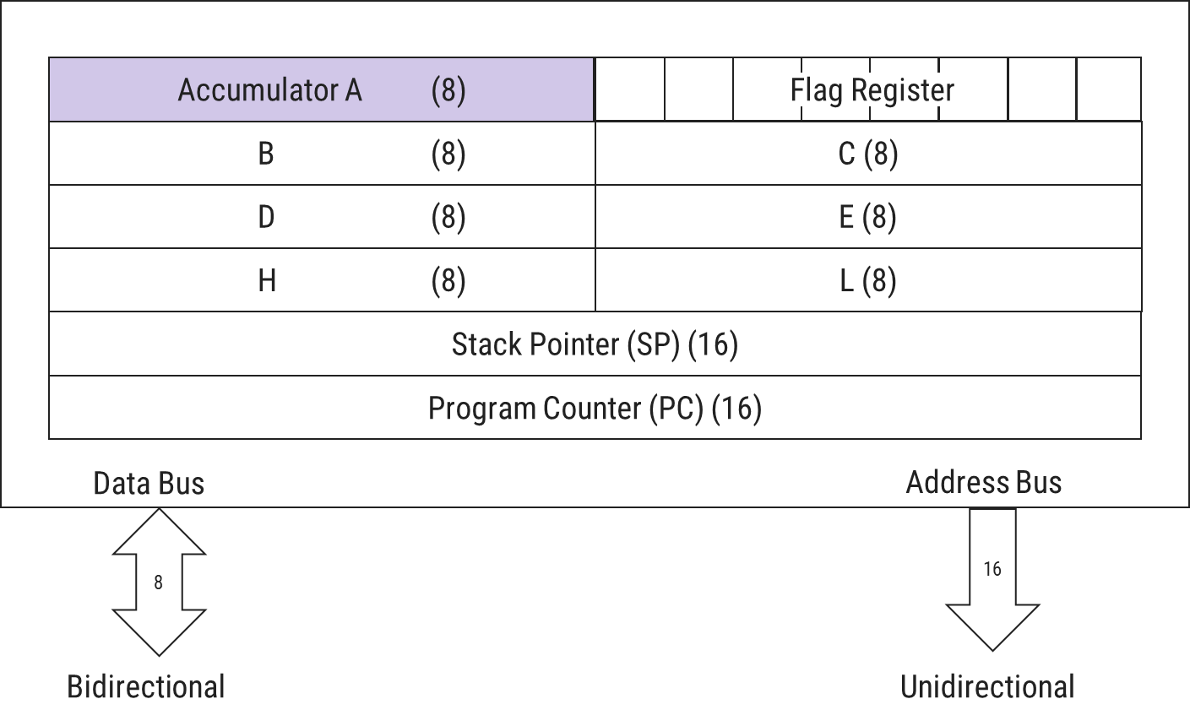
Accumulator
8 - bit register, identified as A
Part of ALU
Used to store 8-bit data to perform arithmetic & logical operations.
Result of operation is stored in Accumulator.

Slide 10
8085 Programming Model
Accumulator A (8)
Flag Register
B (8)
C (8)
D (8)
E (8)
H (8)
L (8)
Stack Pointer (SP) (16)
Program Counter (PC) (16)
Data Bus
Address Bus
8
16
Bidirectional
Unidirectional

Slide 11
Flag Register
D₇ | D₆ | D₅ | D₄ | D₃ | D₂ | D₁ | D₀
S | Z | Χ | AC | Χ | P | Χ | CY
Χ:Undefined
P -Parity Flag
Set (1) if result has even no. of 1’s & Reset(0) if result has odd no. of 1’s
S -Sign Flag
Set (1) if 7th bit of result is 1;
otherwise reset (0)
AC -Auxiliary Carry Flag
Set (1) when carry bit is generated by 3rd bit & passed to bit 4th bit.
CY -Carry Flag
Set (1) if arithmetic operation results in carry;
otherwise reset(0)
1 0 0 1 0 0 1 1
P = 1
1 0 1 0 1 0 1 0
S = 1
Z -Zero Flag
Set (1) when result is zero; otherwise reset(0)
1 1 1
1 0 1 0 1 0 1 0
+ 0 1 1 0 1 0 0 1
1 0 0 0 1 0 0 1 1
CY = 1
1 0 1 0
- 1 0 1 0
0 0 0 0
Z = 1
1 1 1
0 0 1 0 1 0 1 0
+ 0 1 1 0 1 0 0 1
1 0 0 1 0 0 1 1
AC = 1

Slide 12
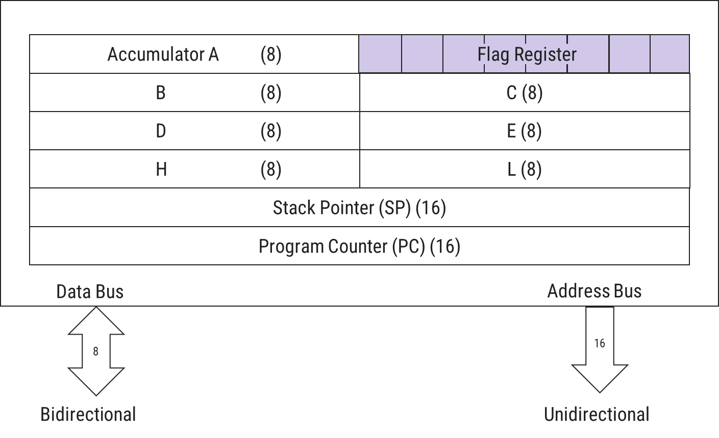
Flag Register
ALU has 5 Flag Register that set/reset after an operation according to data conditions of the result in accumulator & other registers.
Helpful in decision making process of microprocessor.
Conditions are tested through software instructions.
For e.g.
JC (Jump On Carry) is implemented to change the sequence of program when CY(Carry Flag) is set(1).

Slide 13
8085 Programming Model
Accumulator A (8)
Flag Register
B (8)
C (8)
D (8)
E (8)
H (8)
L (8)
Stack Pointer (SP) (16)
Program Counter (PC) (16)
Data Bus
Address Bus
8
16
Bidirectional
Unidirectional

Slide 14
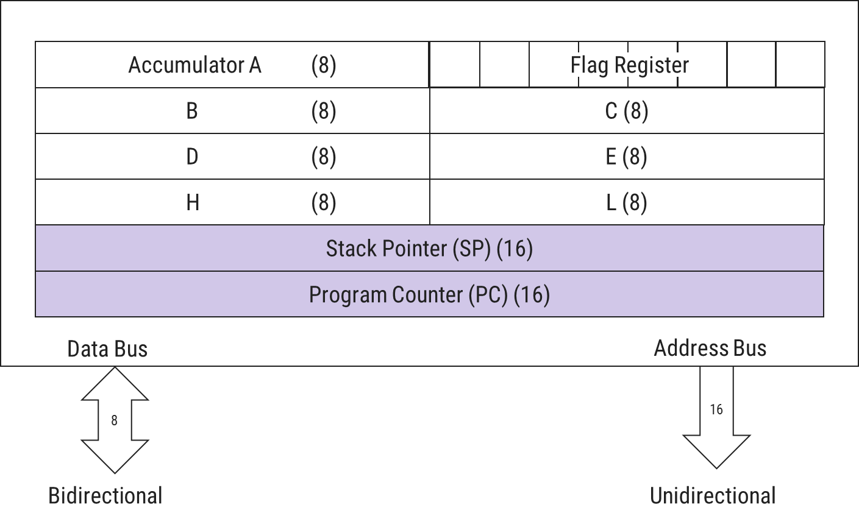
Stack Pointer & Program Counter
Stack Pointer(SP)
Used as memory pointer.
Points to the memory location in R/W memory, called Stack.
Beginning of stack is defined by loading a 16-bit address in the stack pointer.
Program Counter(PC)
Microprocessor uses PC register to sequence the execution of instructions.
Its function is to point to memory address from which next byte is to be fetched.
When a byte is being fetched, PC is incremented by 1 to point next memory location.

Slide 15
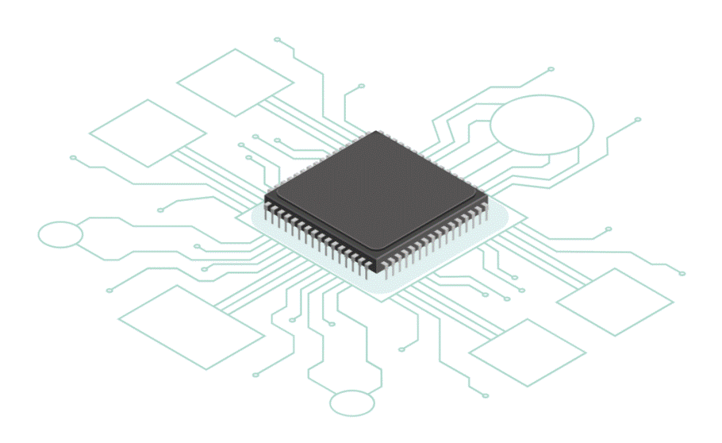
8085 Architecture/Block Diagram

Slide 16
INTA
RST6.5
TRAP
INTR
RST5.5
RST7.5
SID
SOD
Interrupt Control
Serial I/O Control
8-Bit Internal Data Bus
Accumulator (8)
Temp. Reg. (8)
Instruction Reg. (8)
Multiplexer
W (8)
Temp. Reg.
Z (8)
Temp. Reg.
Instruction Decoder and Machine Cycle Encoding
B (8)
Reg.
C (8)
Reg.
8085 Block Diagram
Flag (5) Flip-Flops
D (8)
Reg.
E (8)
Reg.
Register Select
H (8)
Reg.
L (8)
Reg.
Arithmetic Logic Unit (ALU) (8)
Stack Pointer (16)
Power Supply
+5 V
Program Counter (16)
GND
Increment/Decrement Address Latch (16)
X₁
Timing and Control
CLK GEN
X₂
Reset
Control
Status
DMA
Address Buffer (8)
Data/Address Buffer (8)
CLK OUT
RD
WR
S₀
S₁
IO/M
HLDA
RESET OUT
ALE
A₁₅ - A₈ Address Bus
AD₇ – AD₀ Address/Data Bus
READY
HOLD
RESET IN

Slide 17
INTA
RST6.5
TRAP
Used to hold data (i.e. temporary data) during ALU operation.
SID
SOD
RST7.5
Used to store 8-bit data to perform arithmetic & logical operations.
Result of operation is stored in Accumulator.
INTR
RST5.5
Interrupt Control
Serial I/O Control
8-Bit Internal Data Bus
Accumulator (8)
Temp. Reg. (8)
Instruction Reg. (8)
When Instruction is fetched from memory, it is loaded in the Instruction Registor (IR).
Multiplexer
W (8)
Temp. Reg.
Z (8)
Temp. Reg.
Instruction Decoder and Machine Cycle Encoding
B (8)
Reg.
C (8)
Reg.
S | Z |  | AC |  | P |  | CY
Flag (5) Flip-Flops
Instruction decoder decodes the information present in the Instruction register.
D (8)
Reg.
E (8)
Reg.
Register Select
H (8)
Reg.
L (8)
Reg.
Arithmetic Logic Unit (ALU) (8)
Stack Pointer (16)
Program Counter (16)
Increment/Decrement Address Latch (16)
X₁
Timing and Control
CLK GEN
Performs Computing Functions.
Accumulator, Temporary Register and Flag Registers are part of ALU.
Reset
Control
Status
DMA
Address Buffer (8)
Data/Address Buffer (8)
CLK OUT
RD
WR
S₀
S₁
HLDA
RESET OUT
ALE
A₁₅ - A₈ Address Bus
AD₇ – AD₀ Address/Data Bus
READY
HOLD
RESET IN

Slide 18
INTA
RST6.5
TRAP
INTR
RST5.5
RST7.5
SID
SOD
A multiplexer pulls out the right group of bits, depending on the instruction.
Interrupt Control
Serial I/O Control
8-Bit Internal Data Bus
Accumulator (8)
Temp. Reg. (8)
Instruction Reg. (8)
Multiplexer
Two additional 8-bit register, which holds the temporary data during execution of some instructions.
They are used internally, so they are not available to the programmer.
Each register can hold 8-bit data.
These registers can work in pair to hold 16-bit data and their pairing combination is like B-C, D-E & H-L.
W (8)
Temp. Reg.
Z (8)
Temp. Reg.
Instruction Decoder and Machine Cycle Encoding
B (8)
Reg.
C (8)
Reg.
Flag (5) Flip-Flops
D (8)
Reg.
E (8)
Reg.
Register Select
It increments the program counter as instructions execute, increments and decrements the stack pointer as needed, and supports the 16-bit increment and decrement instructions.
H (8)
Reg.
L (8)
Reg.
Arithmetic Logic Unit (ALU) (8)
Stack Pointer (16)
It is a 16-bit register works like stack, which is always incremented/decremented by 2 during push & pop operations.
16-bit register used to store the memory address location of the next instruction to be executed.
Program Counter (16)
Increment/Decrement Address Latch (16)
The content stored in the SP and PC is loaded into the Address Buffer and Data/Address Buffer.
The memory and I/O chips are connected to these buses that can exchange the data.
X₁
Timing and Control
CLK GEN
Reset
Control
Status
DMA
Address Buffer (8)
Data/Address Buffer (8)
CLK OUT
RD
WR
S₀
S₁
HLDA
RESET OUT
ALE
A₁₅ - A₈ Address Bus
AD₇ – AD₀ Address/Data Bus
READY
HOLD
RESET IN

Slide 19
INTA
RST6.5
TRAP
INTR
RST5.5
RST7.5
SID
SOD
Interrupt Control
Serial I/O Control
8-Bit Internal Data Bus
Accumulator (8)
Temp. Reg. (8)
Instruction Reg. (8)
Multiplexer
W (8)
Temp. Reg.
Z (8)
Temp. Reg.
Instruction Decoder and Machine Cycle Encoding
B (8)
Reg.
C (8)
Reg.
Flag (5) Flip-Flops
D (8)
Reg.
E (8)
Reg.
Register Select
H (8)
Reg.
L (8)
Reg.
This unit synchronizes all the microprocessor operations with the clock and generates control signal necessary for communication between microprocessor & peripheral.
Arithmetic Logic Unit (ALU) (8)
Stack Pointer (16)
Read/write either to/from memory or peripherals.
Program Counter (16)
Perform synchronization with peripheral device.
Address Latch Enable control signal
Input signal to synchronize microprocessor with peripheral device.
Frequency Control Signals
DMA control signal
Increment/Decrement Address Latch (16)
Shows read/write status to/from memory or I/O.
X₁
Timing and Control
Signal to RESET microprocessor and other devices connected to it.
CLK GEN
X₂
Reset
Control
Status
DMA
Address Buffer (8)
Data/Address Buffer (8)
CLK OUT
RD
WR
S₀
S₁
HLDA
RESET OUT
ALE
A₁₅ - A₈ Address Bus
AD₇ – AD₀ Address/Data Bus
HOLD
RESET IN
READY

Slide 20
INTA
RST6.5
TRAP
INTR
RST5.5
RST7.5
SID
SOD
Interrupt Control
Serial I/O Control
8-Bit Internal Data Bus
Accumulator (8)
Temp. Reg. (8)
Instruction Reg. (8)
Multiplexer
W (8)
Temp. Reg.
Z (8)
Temp. Reg.
Instruction Decoder and Machine Cycle Encoding
B (8)
Reg.
C (8)
Reg.
Flag (5) Flip-Flops
D (8)
Reg.
E (8)
Reg.
Register Select
H (8)
Reg.
L (8)
Reg.
Arithmetic Logic Unit (ALU) (8)
Stack Pointer (16)
Program Counter (16)
Increment/Decrement Address Latch (16)
X₁
Timing and Control
CLK GEN
X₂
Reset
Control
Status
DMA
Address Buffer (8)
Data/Address Buffer (8)
CLK OUT
RD
WR
S₀
S₁
HLDA
RESET OUT
ALE
A₁₅ - A₈ Address Bus
AD₇ – AD₀ Address/Data Bus
HOLD
RESET IN
READY

Slide 21
INTA
RST6.5
TRAP
INTR
RST5.5
RST7.5
SID
SOD
Interrupt Control
Serial I/O Control
8-Bit Internal Data Bus
%
It controls the serial data communication by using two instructions:
SID (Serial input data)
SOD (Serial output data)
Accumulator (8)
Temp. Reg. (8)
Instruction Reg. (8)
Multiplexer
It controls the interrupts during a process.
There are 5 interrupt signals in 8085 microprocessor:
TRAP, RST 7.5, RST 6.5, RST 5.5, INTR.
W (8)
Temp. Reg.
Z (8)
Temp. Reg.
Instruction Decoder and Machine Cycle Encoding
B (8)
Reg.
C (8)
Reg.
Flag (5) Flip-Flops
D (8)
Reg.
E (8)
Reg.
Register Select
H (8)
Reg.
L (8)
Reg.
Arithmetic Logic Unit (ALU) (8)
Stack Pointer (16)
Program Counter (16)
Increment/Decrement Address Latch (16)
X₁
Timing and Control
CLK GEN
X₂
Reset
Control
Status
DMA
Address Buffer (8)
Data/Address Buffer (8)
CLK OUT
RD
WR
S₀
S₁
HLDA
RESET OUT
ALE
A₁₅ - A₈ Address Bus
AD₇ – AD₀ Address/Data Bus
HOLD
RESET IN
READY

